Slide 1
Linked List

Slide 2
Memory Allocation
Static Allocation
the memory that a data structure might possibly need (as specified by the user) is allocated all at once without regard for the actual amount needed at execution time
Example : Arrays and Strings
Under utilisation of memory
Dynamic Allocation
all the available memory as a large global pool
Memory allocated only when needed ( just the amount needed is allocated)

Slide 3
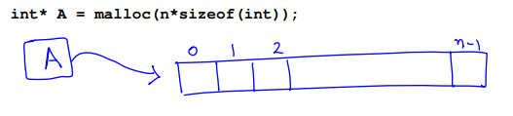


Dynamic Allocation
Allocate memory for n integers
Can be used in any of these ways

Slide 4
Points on memory allocation
The memory allocator keeps track of what is allocated and what is free.
When memory is obtained from the global pool, it contains garbage, and to be properly initialize it.
Not to assume that successive requests will allocate contiguous memory blocks.

Slide 5
Problems with dynamic memory allocation
Freeing memory
Fragmentation of memory

Slide 6
Linked List
A linked list is a data structure which allows to store data dynamically and manage data efficiently
There is a pointer (called header) points the first
Successive nodes are connected by pointers.
Last element points to NULL.
It can grow or shrink in size during execution of a program.
It can be made just as long as required.
It does not waste memory space, consume exactly what it needs.
header
A
B
C
NULL

Slide 7
Arrays
In arrays, elements are stored in a contagious memory locations
Arrays are static data structure
Arrays have spatial locality. Hence give better cache performance
Arrays are suitable for
Inserting/deleting an element at the end.
Randomly accessing any element.
Searching the list for a particular value.

Slide 8
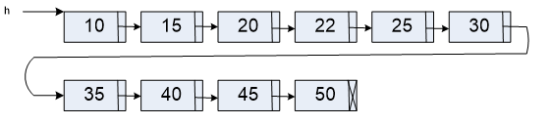
Linked List
In Linked lists
adjacency between any two elements are maintained by means of links(pointers)
It is essentially a dynamic data structure
Linked lists are suitable for
Inserting an element at any position.
Deleting an element from any where.
Applications where sequential access is required.
In situations, where the number of elements cannot be predicted beforehand

Slide 9
Advantages and Disadvantages of Linked Lists
Advantages
Dynamic size
Ease of insertion/deletion
Drawbacks
Random access is not allowed
Additional memory space required for pointer
No spatial locality of reference as elements are stored in non-contiguous locations

Slide 10
Defining a Node of a Linked List
Each structure of the list is called a node, and consists of two fields:
Item (or) data
Address of the next item in the list (or) pointer to the next node in the list
How to define a node of a linked list?
struct node
{
int data /* Data */
struct node *next /* pointer*/
}
node
Data
next
Structures which contain a member field pointing to the same structure type are called self-referential structures.

Slide 11
Creation of Singly linked List (C Program)
struct Node {
int data
struct Node* next
}
int main( ) {
struct Node* n1 = NULL
struct Node* n2 = NULL
struct Node* n3 = NULL
struct Node *Head
n1 = (struct Node*) malloc ( sizeof ( struct Node))
n2 = (struct Node*) malloc ( sizeof ( struct Node))
n3 = (struct Node*) malloc ( sizeof ( struct Node))
0x52e
n1
0x62a
n2
0x43d
n3

Slide 12
0x52e
n1
0x62a
Head = n1
n1 -> next = n2
n2 -> next = n3
n3->next = NULL
n2
0x43d
n3
0x52e
0x62a
0x43d
Head
NULL
n1
n2
n3

Slide 13

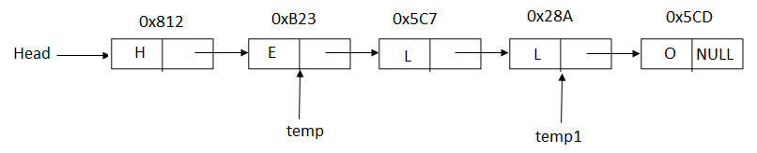
Exercise

Slide 14
Evaluate the following expressions:
What address value is held by temp->next?
What does temp->next->data evaluate to?
What does (Head->next->next == temp) evaluate to?
Using Head, temp, temp1 how can we access ‘O'?
How does the following statements change our diagram
temp->next = temp1
temp1 = temp->next->next
Head = head->next
temp1 = Null

Slide 15
Algorithm to print the values stored in a linked list
Algorithm print(L)
1. temp = L
2. while(temp != NULL)
print (temp -> data)
temp = temp->next
3. end

Slide 16
Algorithm to count the nodes in a linked list
Algorithm print(L)
temp = L
count = 0
3. while(temp != NULL)
count = count + 1
temp = temp->next
4. print count
5. end
O(n)

Slide 17
Write an algorithm that returns true if there is a node in the list with a value equal to the given value x.

Slide 18
Write an algorithm to return true if there is a node in the list with a value equal to the given value x.
Algorithm search(L, x)
1. temp = L
2. while(temp != NULL) AND (temp ->data != x)
temp = temp->next
3. if (temp == null)
return False
else
return true

Slide 19
Write an algorithm to find the last node of a Linked List.

Slide 20
Write an algorithm to find the last node of a Linked List.
Algorithm lastNode(L)
1. temp = L
if (temp == NULL)
return NULL
3. while (temp ->next != NULL)
temp = temp->next
4. return temp

Slide 21
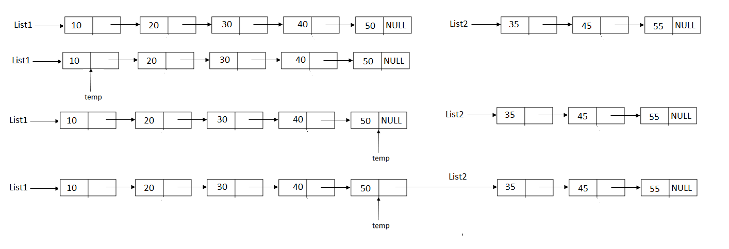
Concatenate two lists

Slide 22
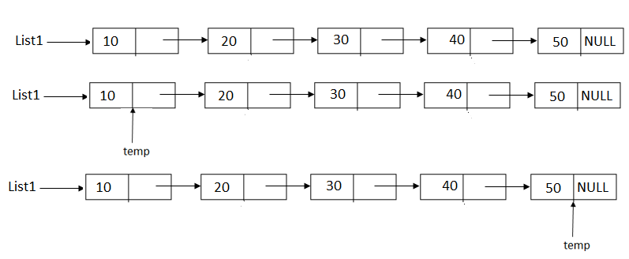
Concatenate two lists
Algorithm Concatenate(List1, List2)
If List1 == Null
return List2
If List2 == Null
return List1
Temp = List1
While (temp -> next != Null)
temp = temp -> next
Temp -> next = List2
Return List1

Slide 23
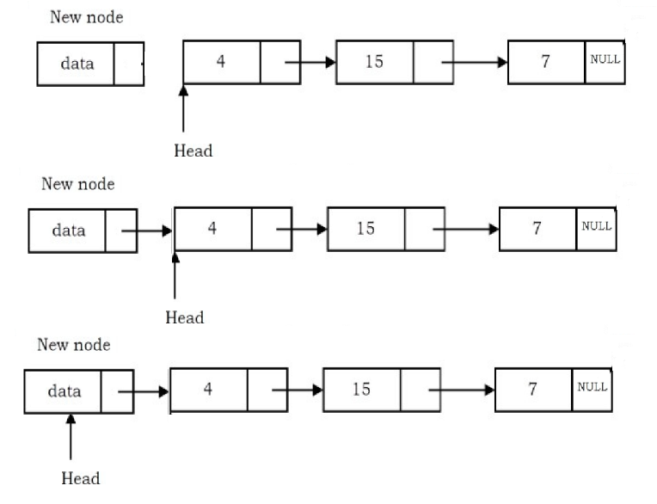
Insert at the beginning of a list
Algorithm InsertAtHead(Head, elt)
newnode = getnode(NODE)
newnode → data = elt
newnode → next = Head
Head = newnode
end

Slide 24
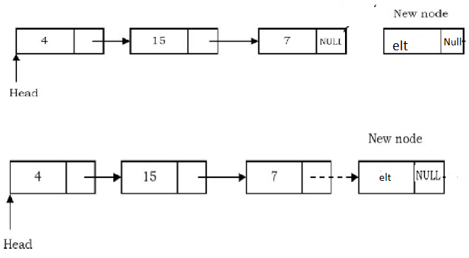
Insert at end of the List
Algorithm InsertEnd(Head, elt)
newnode = getnode(NODE)
newnode → data = elt
newnode → next = NULL
If Head == NULL
Head = newNode
return
temp = Head
While (temp → next != NULL)
temp = temp → next
7. temp → next = newnode
8. end

Slide 25
Insert in Sorted List
Case:
Empty List
Element less than the first element
Element in any other position

Slide 26


Insert in empty List
Insert 25
Head NULL
Step 1
Step 2
Step 3
Step 4
Head

Slide 27

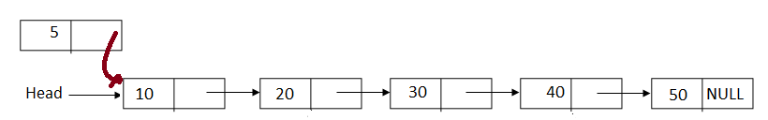
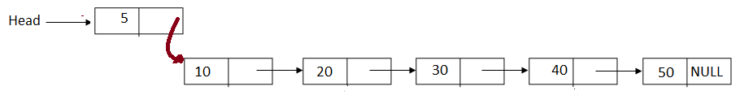
Insert in sorted List
Insertion in the beginning
Insert 5
Step 1
Step 2
Step 3
Step 4

Slide 28
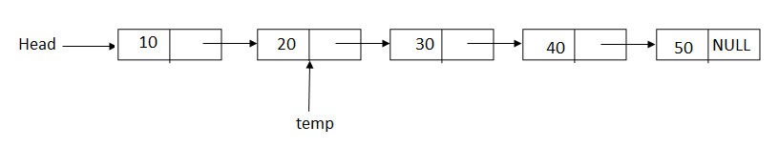
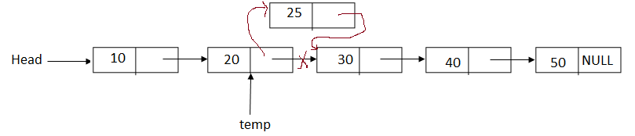
Insert in sorted List
Insert 25
Step 1
Step 2
Step 3
Step 4

Slide 29
Algorithm InsertSortedList(Head, elt)
1. Get memory for new element
2. Store elt in new node
3. If existing list is empty, set the new node as resultant list
4. If elt is less than the first element, add new node in the beginning of the list
5. Move the pointer while the data in the next node is smaller than the elt and insert the new node

Slide 30
Algorithm InsertSortedList(Head, elt)
1. [Get memory for new element]
newNode = getNode(NODE)
2. [Store elt in new node]
newNode->data = elt
3. [If existing list is empty, set the new node as resultant list]
If ( Head==NULL )
newNode->next = NULL
Head = newNode
return
4. [If elt is less than the first element, add newnode in the beginning of the list]
If ( elt < Head->data )
newNode->next = Head
Head = newNode
return
5 . [Move the pointer while the data in the next node is smaller than the elt and insert the new node]
Temp =head
6. while(temp->next != NULL AND temp ->next->data < elt)
tem = temp -> next
7. newNode->next = temp->next
8. temp->next = newNode
Return

Slide 31
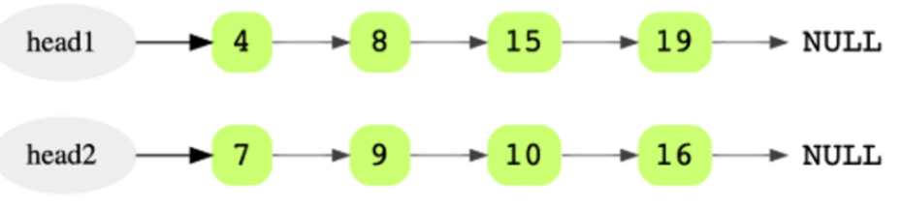
Merge two sorted lists
Input
Output

Slide 32
Algorithm mergeList ( List1, List2 )
if (List1 == Null)
return List2
else if (List2 == Null)
return List1
if (List1->data <= List2->data) {
mergedList = List1
List1 = List1->next
} else {
mergedList = List2
List2 = List2->next
}
mergedTail = mergedList
while (List1 != Null AND List2 != Null) {
temp = Null
if (List1->data <= List2->data) {
temp = List1
List1 = List1->next
} else {
temp = List2
List2 = List2->next
}
mergedTail->next = temp
mergedTail = temp
}
if (List1 != Null)
mergedTail->next = List1
else if (List2 != Null)
mergedTail->next = List2
return mergedList

Slide 33
Delete a node
Delete the first node in the list
Delete the last node
Delete the node that has the given key
Delete the list

Slide 34
Delete the first node in the list
Algorithm DeleteFirst(List)
If ( List == NULL)
return
Temp = List
List = List -> next
Free(temp)
return

Slide 35
Delete the last node
Algorithm DeleteLast(List)
1. If (List == Null)
return Null
2. If (List -> next == NULL)
free (List)
return Null
3. temp = List
4. while (temp->next-next != Null)
temp = temp -> next
5. free(temp->next)
6. temp ->next = NULL
7. return List

Slide 36

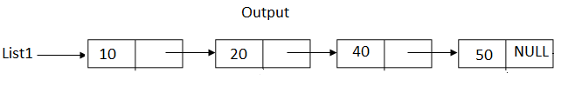
Delete the node with the given key
DeleteKey(List, 30)

Slide 37
Delete the node with the given key - Algorithm DeleteKey(List, key)

Slide 38
Delete the node with the given key - Algorithm DeleteKey(List, key)
Algorithm DeleteKey(List, key)
If (List == NULL)
return NULL
prev = NULL
3. if (List → data == key)
temp = List
List = List → next
free (temp)
4. temp = List
5. while(temp!=NULL and temp → data != Key)
prev = temp
temp = temp -> next
4. If (temp != Null)
prev->next = temp -> next
free(temp)
5. return List

Slide 39
Linked Stack
Stacks implemented using Linked Lists
Push operation – insertion at top – insertion at beginning of the list
Pop operation – deletion from top – deletion of first node in the list

Slide 40
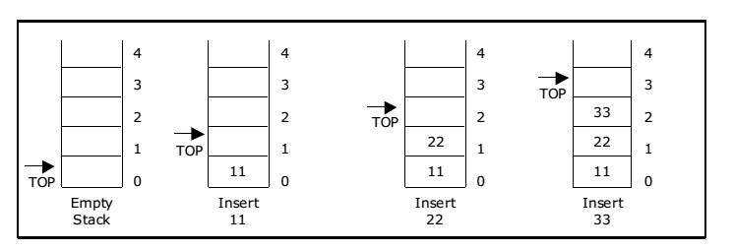
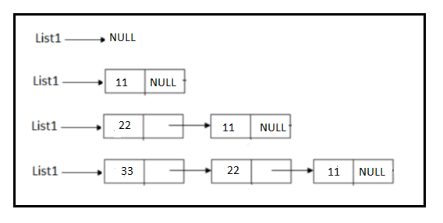
Push Operation
Array Implementation
Linked List Implementation

Slide 41
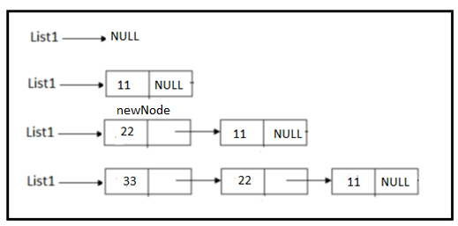
Linked Stack – Push Operation
Algorithm Push(S, elt)
newNode = getnode(Node)
newNode->data = elt
newNode->next = S
S= newNode
end

Slide 42
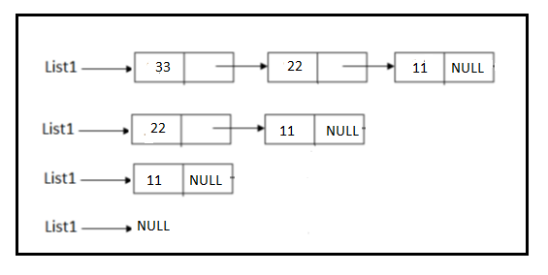
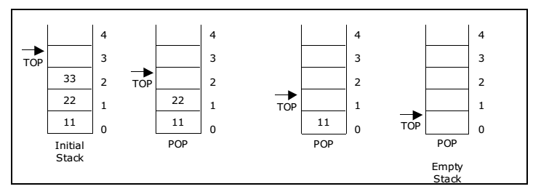
Pop Operation
Array Implementation
Linked List Implementation

Slide 43
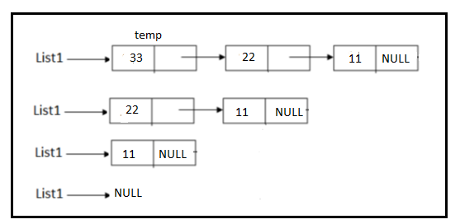
Linked Stack – Pop Operation
Algorithm Pop(S, elt)
If (S == Null)
print “Stack Underflow”
return
Temp = S
S = S->next
Free (temp)
5. end

Slide 44
Linked Queue
Insert operation – insert at rear end - insert at the tail of the list
Delete operation – deletion from the front – delete from the head of the list

Slide 45
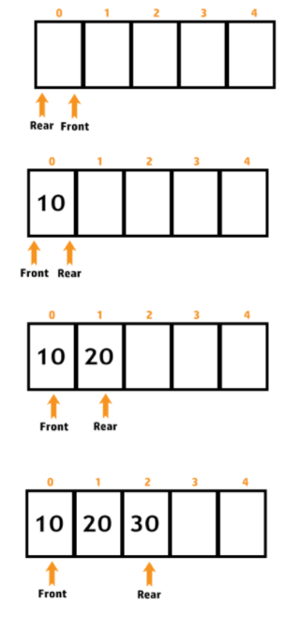
Linked Queue - Insertion
Algorithm LQInsert( Q, elt)
newNode = getNode(Node)
newNode->data = elt
newNode->next = Null
If (Q.Rear == Q.Front == Null)
Q. Rear = Q. Front = newNode
else {
Q.Rear->next = newNode
Q.Rear = newNode
}
5. Return

Slide 46
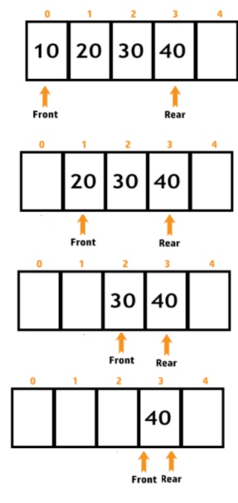
Linked Queue - Deletion
Algorithm LQDelete(Q)
If (Q.Front == Q.Rear == Null)
print “Q underflow”
return
If (Q.Front == Q.Rear)
free (Q.Rear)
Q.Front = Q.Rear = Null
return
Temp = Q.Front
Q. Front = Q.Front ->next
Free (temp)
return

Slide 47
What does the function do?
Algorithm func(s,c)
if (s==Null)
return 0
x = func(s->next, c)
if (s.data==c)
x++
return x

Slide 48
What does the function do?
Algorithm func(s,c)
if (s==Null)
return 0
x = func(s→next, c)
if (s → data == c)
x++
return x
Count the number of nodes with value c

Slide 49
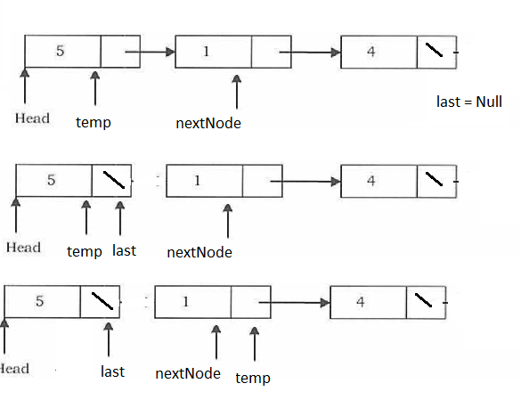
Reverse a Singly linked list
Algorithm reverseList(Head)
last = NULL
temp = L
While (temp != NULL)
nextNode = temp -> next
temp ->next = last
last = temp
temp = nextNode
4. Head = last

Slide 50
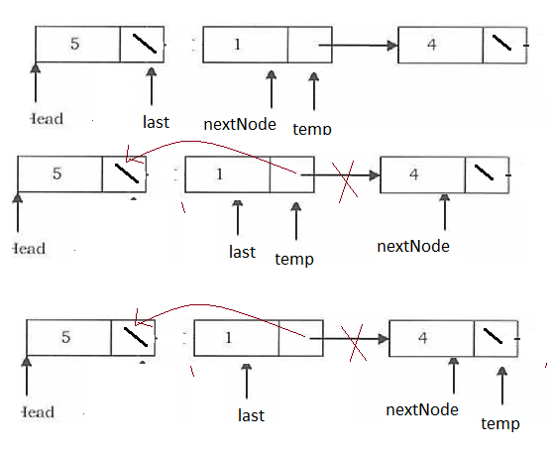
Reverse a Singly linked list
Algorithm reverseList(Head)
last = NULL
temp = L
While (temp != NULL)
nextNode = temp -> next
temp ->next = last
last = temp
temp = nextNode
4. Head = last

Slide 51
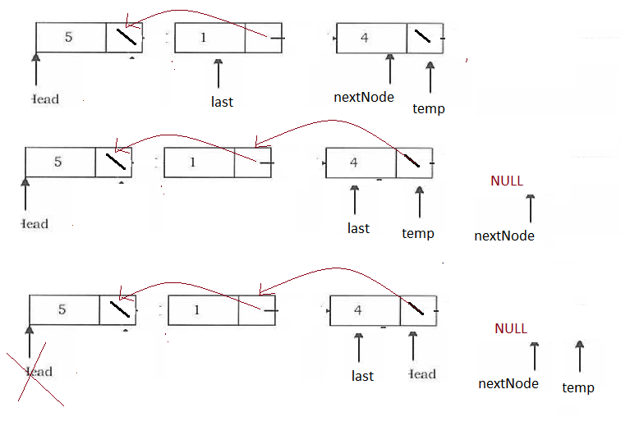
Reverse a Singly linked list
Algorithm reverseList(Head)
last = NULL
temp = L
While (temp != NULL)
nextNode = temp -> next
temp ->next = last
last = temp
temp = nextNode
4. Head = last

Slide 52
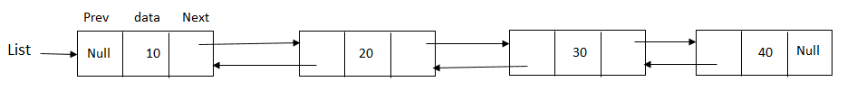
Doubly Linked List
Linked List with two pointers pointing to previous and next element of the list
struct DLNode{
int data;
struct DLNode *prev;
struct DLNode *next;
}

Slide 53
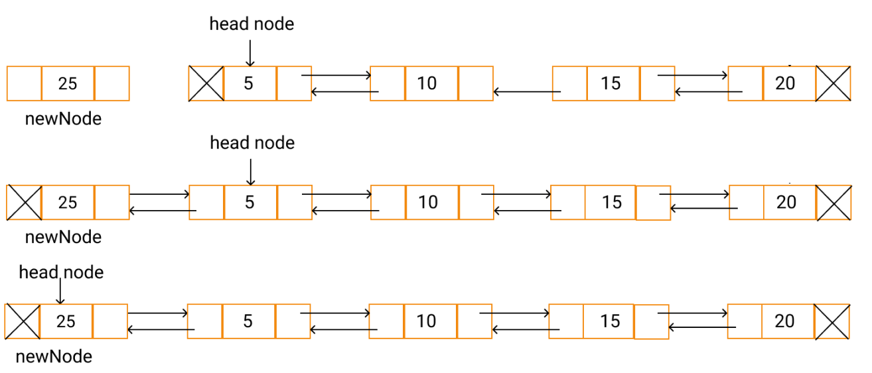
Insertion in DLL
Algorithm InsertBeginDLL(Head, elt)
newNode = getNode(NODE)
newNode → data = elt
newNode → prev = NULL
If Head == NULL
newNode → next = NULL
Head = newNode
return Head
5. newNode → next = Head
6. Head → prev = newNode
7. Head = newNode
8. return Head

Slide 54
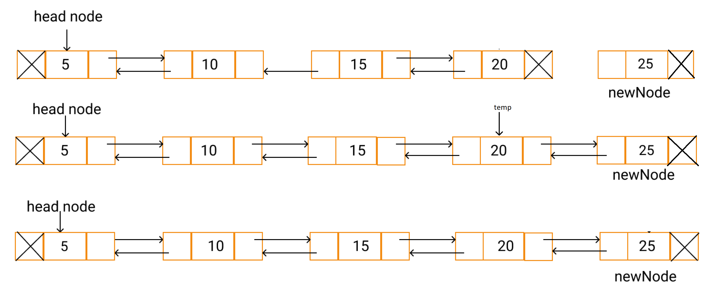
Insertion at end in DLL
Algorithm InsertEndDLL(Head, elt)
newNode = getNode(NODE)
newNode → data = elt
newNode → next = NULL
If Head == NULL
newNode → next = NULL
Head = newNode
return Head
5. temp = Head
6. While (temp → next != NULL)
temp = temp → next
7. temp → next = newNode
8. newNode → prev = temp
9. return Head

Slide 55
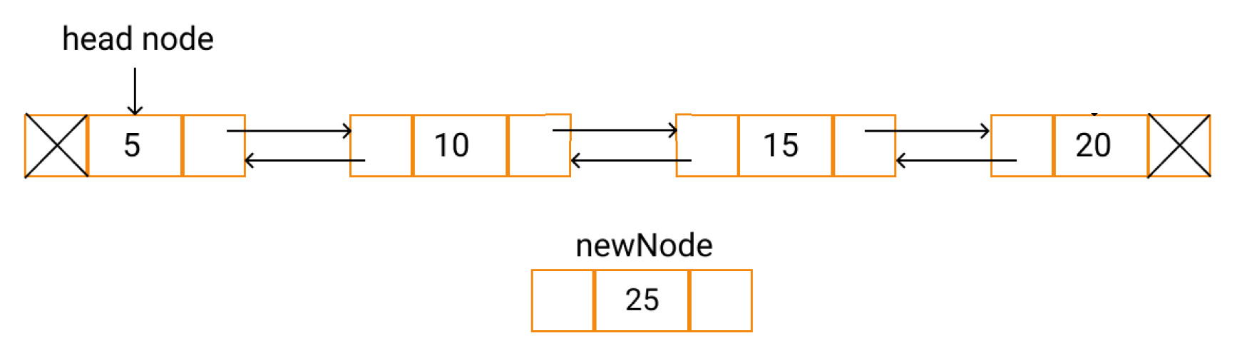
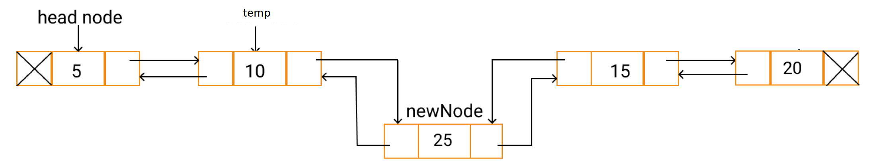
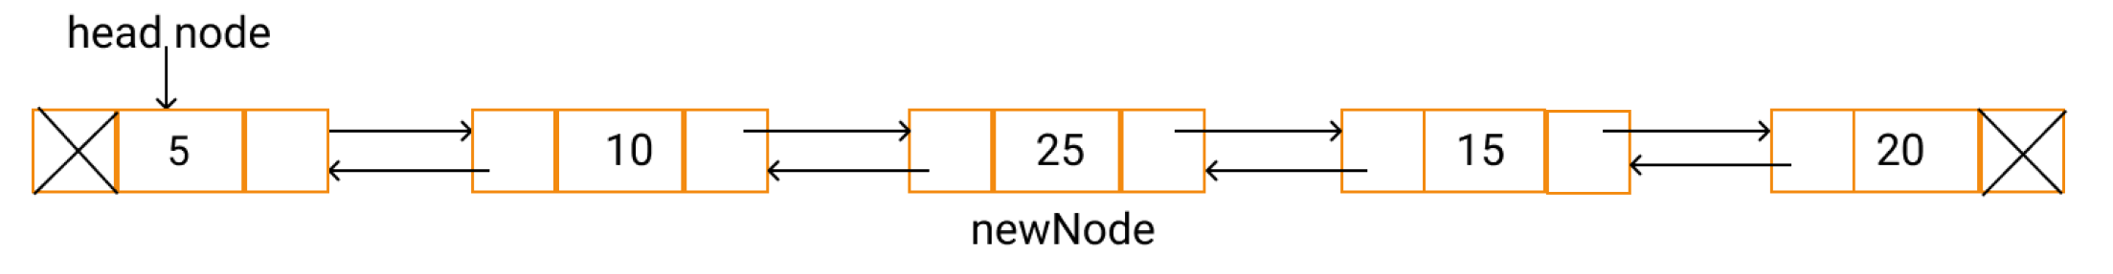
Insertion at the given position in DLL
Algorithm insertPosDLL(Head, elt, position)
If (Head == NULL)
Print "Error, Empty List”
return
temp = head
i = 1
while (i < position-1 AND temp != NULL)
temp = temp → next
i = i + 1
if (temp!=NULL)
newNode = getNode (NODE)
newNode → data = elt
newNode → next = temp → next
newNode → prev = temp
if(temp → next != NULL)
Temp → next → prev = newNode;
Temp → next = newNode;
else
print "Error, Invalid position”
return Head
insertPosDLL(Head, 25, 3)

Slide 56
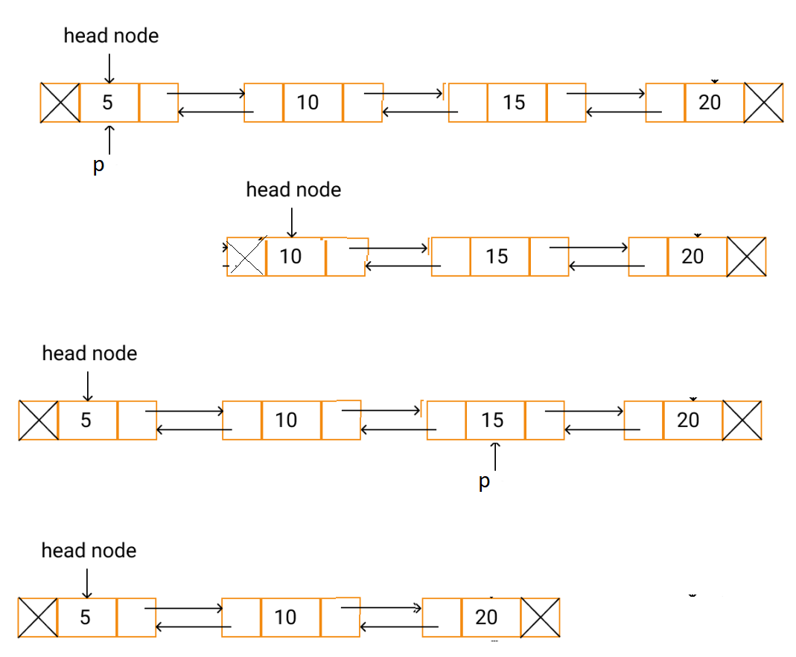
Deletion in DLL
Algorithm DeleteNodeDLL(Head,p)
If Head == NULL
print “ Empty List”
return NULL
If ( p == Head )
Head = Head →next
Head →prev = NULL
free (p)
return Head
p →prev →next = p → next
p →next →prev = p → prev
free (p)
Return Head

Slide 57
Search in DLL
Algorithm search(head, value):
1. If head == NULL
return NULL
2. temp = head;
3. while (temp-> data != value and temp->next != NULL)
temp = temp->next;
4. if (temp->data != value)
return NULL
else
return temp

Slide 58
Insert elt after value if value found; Otherwise insert after last node
Algorithm insertafter(head, elt, value)
[insert elt after value if value found ; otherwise at end]
newNode = getnode(NODE)
newNode -> data = elt
if head == Null {
newNode -> next = newNode-> prev = NULL
head = newNode
return head
}
temp = head
while (temp-> data != value and temp->next != NULL)
temp = temp->next;
if (temp -> next == Null) {
newNode -> prev = temp
newNode -> next = NULL
temp -> next = newNode
return head
}
else if (temp -> data == value) {
newNode -> next = temp -> next
newNode -> prev = temp
temp -> next -> prev = newNode
temp -> next = newNode
return head
}

Slide 59
Exercises on DLL
Insert node into a sorted DLL
Insert node after the given element in a DLL
Insert node before the given element in a DLL
Delete given element in a DLL
Delete a given element in a sorted DLL
Delete the node in the given position in a DLL

Slide 60
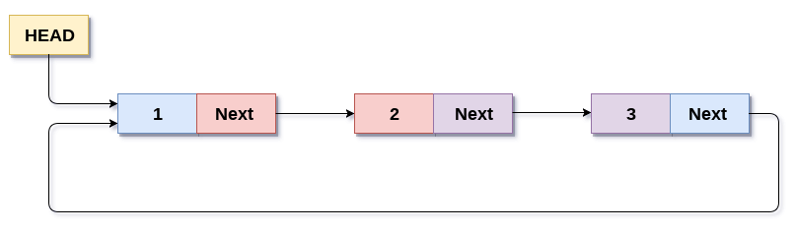
Circular Linked List (CLL)
The next field of last node points to the first node
Can traverse the list from any node

Slide 61
Count the number of nodes in a CLL
Algorithm countCLL(Head)
1. temp = Head
2. count = 0
3. if (head != NULL) {
do {
temp = temp -> next
count = count +1
} while ( temp != Head)
}
4. return count

Slide 62
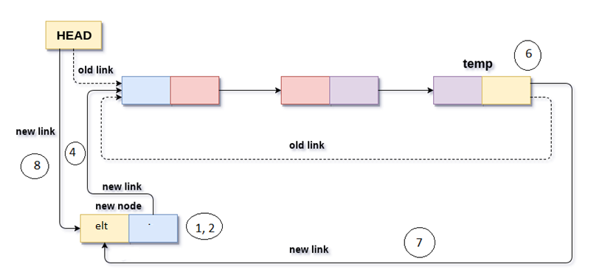
Insertion at the beginning of CLL
Algorithm InsertBegCLL(Head, elt)
newNode = getNode(NODE)
newNode → data = elt
If Head == NULL
newNode -> next = newNode
Head = newNode
return Head
Temp = Head
newNode → next = Head
While (temp →next ! = Head)
temp = temp → next
Temp → next = newNode
Head = newNode
end

Slide 63
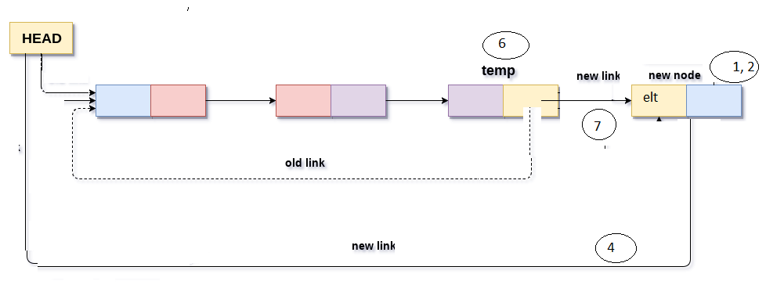
Insertion at end of CLL
Algorithm InsertEndCLL(Head, elt)
1. newNode = getNode(NODE)
2. newNode → data = elt
3. if Head == Null
newNode → next = newNode
Head = newNode
4. newNode → next = Head
5. temp = Head
6. while (temp → next !=Head)
temp = temp → next
7. temp → next = newNode
8. end

Slide 64
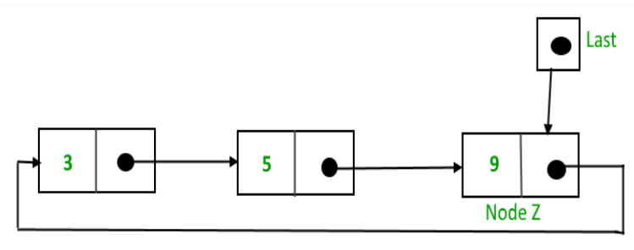
Complexity of Insertion
When pointer to head (first node) is maintained, the entire list has to be traversed to insert a node either in the beginning or end of the list
Complexity of insertion is O(n)
Maintaining a pointer to last node, complexity reduces to constant time.

Slide 65
Traversal
Algorithm traversalCLL(last)
If ( last == NULL)
return
2. temp = last → next
3. do {
print temp → data
temp = temp → next
} while ( temp != last → next)

Slide 66
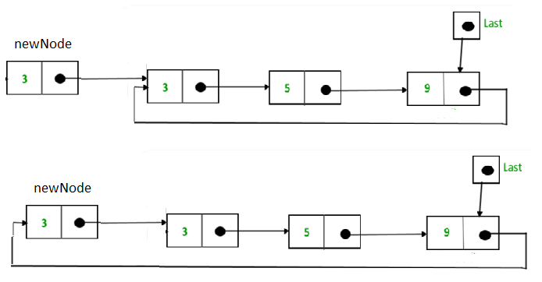
Insertion at beginning of CLL
Algorithm InsertBeginCLL(last, elt)
newNode = getNode(NODE)
newNode -> data = elt
3. if (last == NULL)
newNode->next = newNode
last = newNode
return last
4. newNode->next = last->next
last -> next = newNode
return last

Slide 67
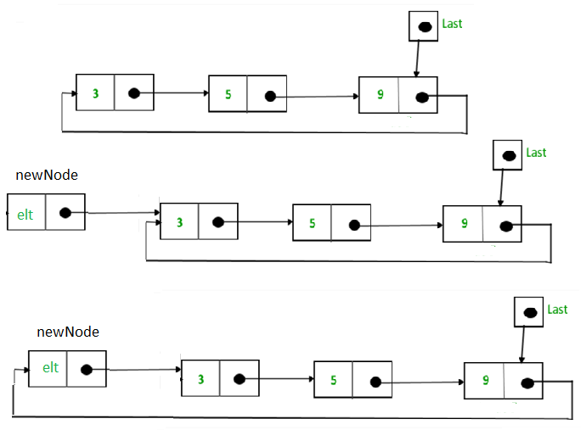
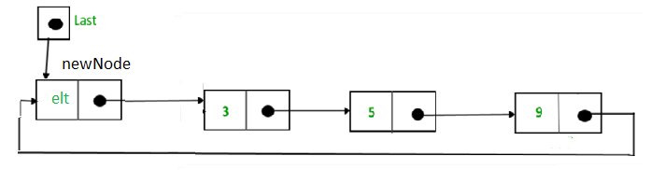
Insertion at end of CLL
Algorithm InsertEndCLL(last, elt)
1. newNode = getNode(NODE)
2. newNode → data = elt
3. if (last == NULL)
newNode → next = newNode
last = newNode
return last
4. newNode → next = last → next
5. last → next = newNode
6. last = newNode
7. return last

Slide 68
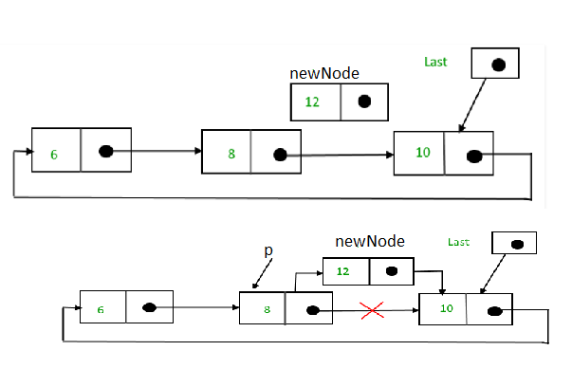
Insert elt after item in CLL
Algorithm InsertAfterCLL(last, elt, item)
[ insert elt after item ]
1. if (last == NULL)
return NULL
2. p = last -> next // first node
3. newNode = getNode(NODE)
4. newNode → data = elt
5. do { // search
if (p ->data == item) {
newNode → next = p -> next
p → next = newNode
if (p == last) // Checking for the last node
last = newNode
return last
}
p = p → next
} while (p != last → next)
6. Print “Item not present in the list"
7. return last

Slide 69
Comparison
Linked lists vs. arrays
Elements can be inserted into linked lists, while an array will eventually either fill up or need to be resized
Array allows random access, while linked lists allow only sequential access to elements.
Extra storage is needed for linked lists for references
Doubly linked vs. singly linked
Doubly linked lists require more space per node, and their operations are more expensive; but they are easier to manipulate because they allow sequential access in both directions.
For example, insert or delete a node in constant number of operations given only that node's address.

Slide 70
Comparison
Circularly linked vs. linearly linked
Circular linked lists are most useful for describing naturally circular structures, and have the advantage of a regular structure and being able to traverse the list starting at any point.
They also allow quick access to the first and last records through a single pointer (the address of the last element).
Their main disadvantage is the complexity of iteration, which has special cases.
Sentinel nodes
Sentinel nodes may simplify certain list operations, by ensuring that the next and/or previous nodes exist for every element.
However sentinel nodes use up extra space (especially in applications that use many short lists), and they may complicate other operations.
To avoid the extra space requirement the sentinel nodes can often be reused as references to the first and/or last node of the list.

Slide 71
Multiply Linked List
Node has multiple pointer fields
Useful in linking nodes with respect to several attributes other than predecessor and successor

Slide 72
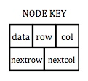
Multiply Linked List
Every node in the linked list has links to several nodes of the list
Example – Sparse matrix representation
0 | 0 | 0 | 9 | 0
0 | 8 | 0 | 0 | 0
7 | 0 | 0 | 6 | 0
0 | 0 | 0 | 0 | 0
0 | 5 | 0 | 0 | 0

Slide 73
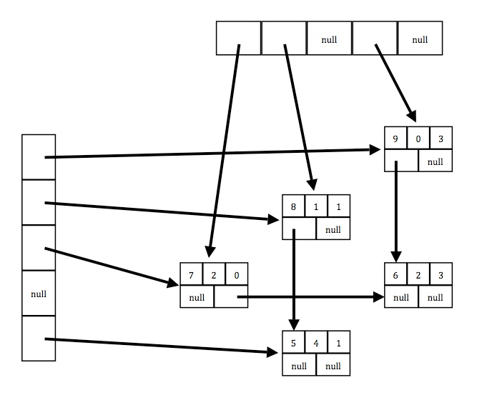
Sparse Matrix Representation using multiply linked list
0 | 0 | 0 | 9 | 0
0 | 8 | 0 | 0 | 0
7 | 0 | 0 | 6 | 0
0 | 0 | 0 | 0 | 0
0 | 5 | 0 | 0 | 0

Slide 74
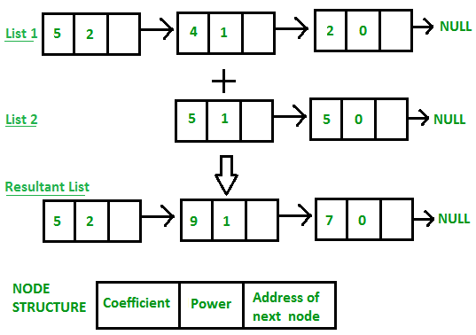
Representation of Polynomials using Linked List
5x² + 4x + 2
5x + 5
----------------------
5x² + 9x + 7

Slide 75
Addition of Polynomials
Algorithm polyadd(List1, List2, List)
P1 = List1; P2 = List2 ; P = Null ; PTail = Null
while (P1!= NULL AND P2 != NULL) {
if (P1->pow > P2->pow) {
addterm(P, Ptail, P1->pow, P1->coeff)
P1 = P1->next;
}
else if (P1->pow < P2->pow) {
addterm(P, Ptail, P1->pow, P1->coeff)
P2 = P2->next;
}
else {
if (P1->coeff + p2->coeff != 0) {
addterm(P, Ptail, P1->pow, P1->coeff + p2->coeff)
P1 = P1->next;
P2 = P2->next;
}
}
}

Slide 76
if ( P2 != Null)
P1 = P2
while (P1 != Null ) {
addterm(P, Ptail, P1->pow, P1->coeff)
P1 = P1->next;
}

Slide 77
Algorithm addterm(P, Ptail, power, coeff)
newNode = getNode(NODE)
newNode -> pow = power
newNode -> coeff = coeff
newNode -> next = Null
If (P == Null)
P = Ptail = newNode
else {
Ptail -> next = newNode
Ptail = newNode
6. end

Slide 78
Representation of Large number using Linked List
N = 2345679824356575877876989123
Suppose only numbers with maximum 5 digits can be stored in memory
Digits can be split into pieces and represent each piece as a node in a linked list
5679824356575877876989123

